Slide 1
SQL-Based Financial Transaction Analysis and Fraud Detection Using PaySim Dataset
Submitted by:
Fatima Khuram (24L-5567)
Sehar Taimoor (24L-5584)
Areesha Talha (24L-5504)
Somal Fatima (24L-5715)
Anfaal Batool (24L-5018)

Slide 2
PaySim Dataset Overview
What is PaySim?
Key Features
Simulated mobile financial transaction dataset
Designed to mimic real-world banking systems
Sender and receiver accounts
Transaction amount and balance changes
Fraud and flagged fraud indicators
Transaction types (payment, transfer, cash out, etc.)
Why it is used?
Fraud detection and financial risk analysis
Used in fintech research and banking analytics
Helps simulate real banking transaction behavior

Slide 3
Database Schema (3NF)
Transactions
Customers
Column | Type | Description | Tag
CustomerID | PK · INT
CustomerName | VARCHAR · UNIQUE
TransactionID | PK · INT | Primary key
Step | INT | Transaction time step
TypeID | INT · FK | TransactionTypes.TypeID | FK
OrigCustomerID | INT · FK | Customers.CustomerID (Sender) | FK
DestCustomerID | INT · FK | Customers.CustomerID (Receiver) | FK
Amount | DECIMAL(18,2) | Transaction amount
OldBalanceOrg | DECIMAL(18,2) | Sender balance before
NewBalanceOrig | DECIMAL(18,2) | Sender balance after
OldBalanceDest | DECIMAL(18,2) | Receiver balance before
NewBalanceDest | DECIMAL(18,2) | Receiver balance after
IsFraud | TINYINT(1) | Fraud label (0 / 1) | FLAG
IsFlaggedFraud | TINYINT(1) | System fraud flag (0 / 1) | FLAG
TransactionTypes
TypeID | PK · INT
TypeName | VARCHAR · UNIQUE
Relationships: Customer 1→N Transactions (Sender) · Customer 1→N Transactions (Receiver) · TransactionType 1→N Transactions

Slide 4
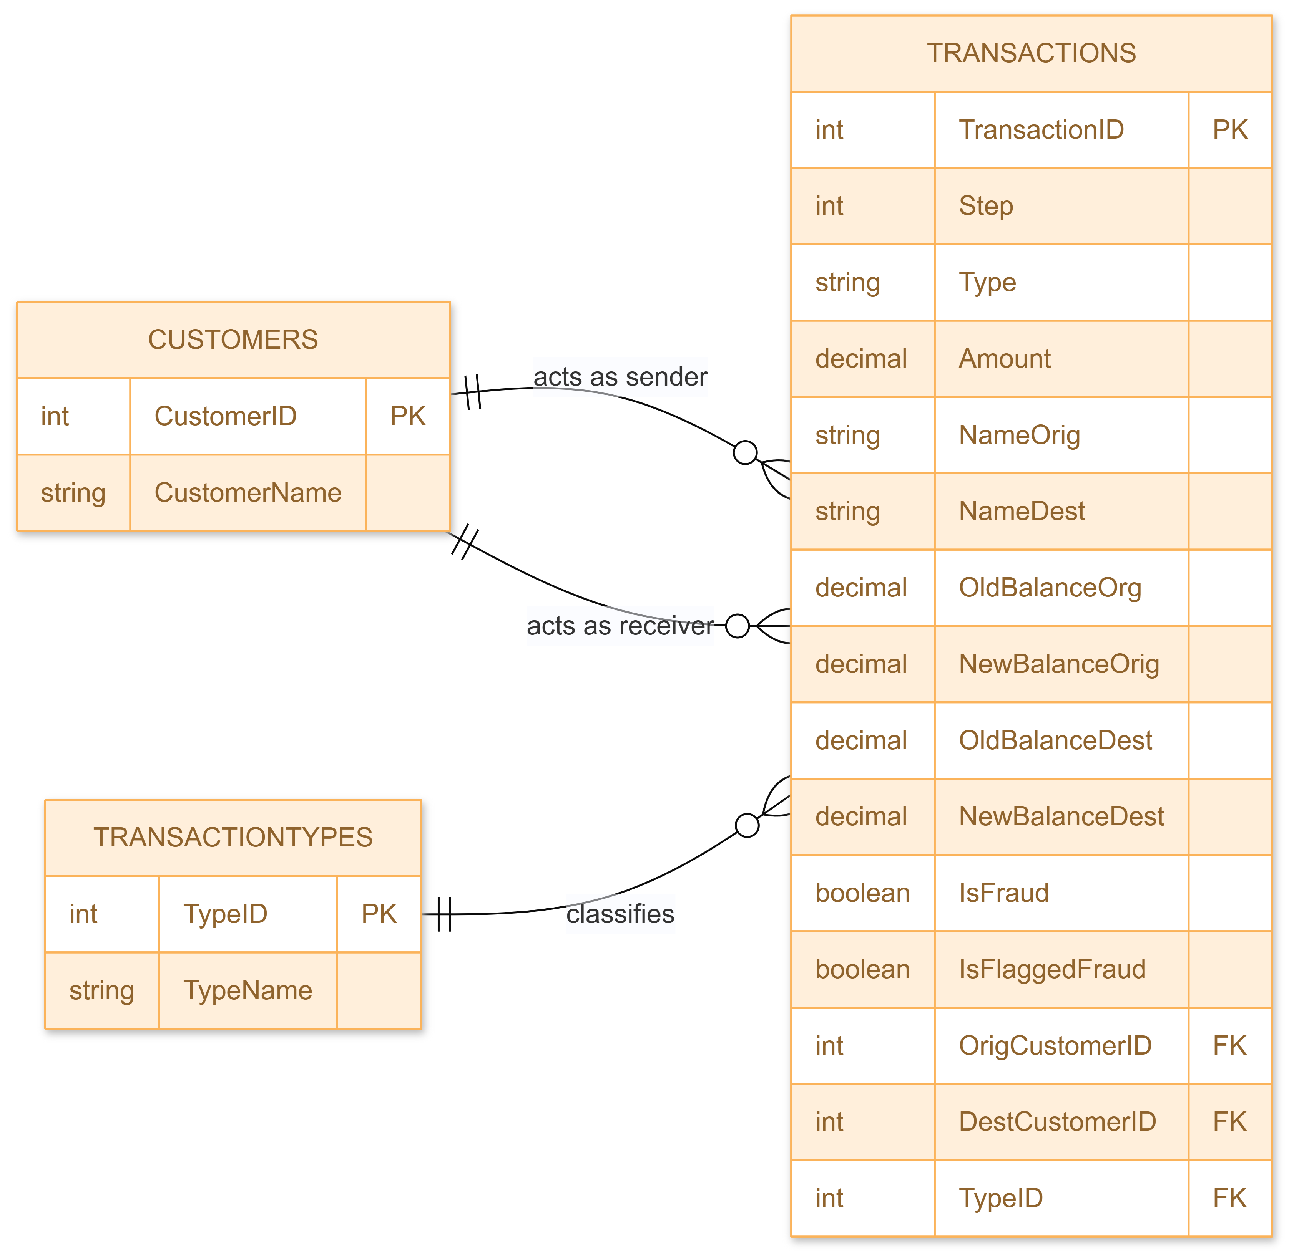
ER Diagram

Slide 5
Relevance to FinTech & DBMS & Business Value
Used in digital banking fraud detection systems
Helps in real-time transaction monitoring
Supports risk analysis and compliance reporting
Applied in banking decision-making systems
Builds foundation for financial analytics and AI fraud models
Helps detect fraud patterns in banking transactions
Supports real-time financial monitoring systems
Improves risk management and compliance
Enables data-driven banking decisions
Useful for fintech analytics and auditing systems

